Slide 1

Task Planner
7/26/2016
TimeLords
Julia Moffitt-Product Owner
Sergiy Ravnyago-Developer
Brian Houts-Developer
Jeff Wagenseller-Developer
Michaela Molina-Developer
TP
TP
Notes:
Everyone introduces themselves

Slide 2
Introduction
Task Planner is an android application in which the user can add tasks to designated projects including certain attributes about this task.
Solving Problem: Need a way to organize to-do lists
Beneficial to: People who want to be more productive
Notes:
Brian
Our application Task Planner is a great tool for people who have a large to-do list and a desire to get more done. Task Planner allows for organizing tasks by projects as well as individually.

Slide 3
Goals
Initial Vision: An application that makes organizing tasks fun and easy
Final Result: An application that effectively allows organization of tasks
Notes:
Julia
In our experience there are not many good applications out their for task management available for android. So we wanted to make create one that was intuitive and well designed for our users. We were influenced by the ios application Getting things Done.

Slide 4
Challenges
Software Product:
Database
Crashes
Software Development Process:
Communicating sufficiently
Git and Android app development
Notes:
Jeff
We made the database a lower priority for our application. Upon creation we had trouble integrating it with the rest of the project. Communication was definitely something we needed improvement on as a team. Git was also new to all of us. We experienced many git merge conflicts and a few of us pushed older versions settings us back a bit. Lastly, one of our group member’s computer’s stopped working with internal edits stuck on their dead computer.

Slide 5
Technical Overview
Technologies Used:
JAVA programming language
Android Studio IDE
AVD Android Emulator
Android SQLite Database
Sugar OCR
Architecture Diagram: Implemented Pages
HOME
Edit Task
Edit Project
Dump
Notes:
Michaela
We implemented the four pages which are essential to task planning, including the home page, which features a menu, as well as an edit task and edit project pages, and a handy dump page where a user can quickly store tasks. We used the standard technologies of the Java programming language and Android Studio.

Slide 6
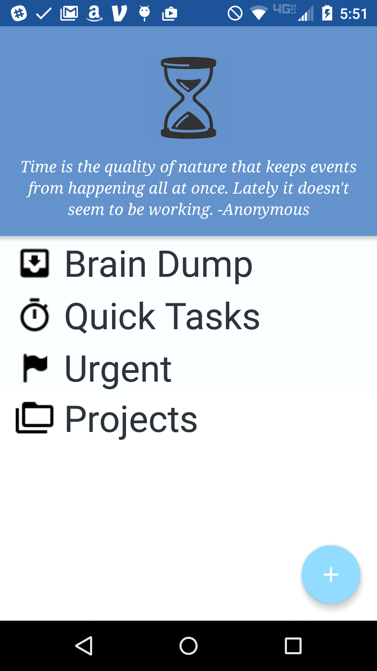
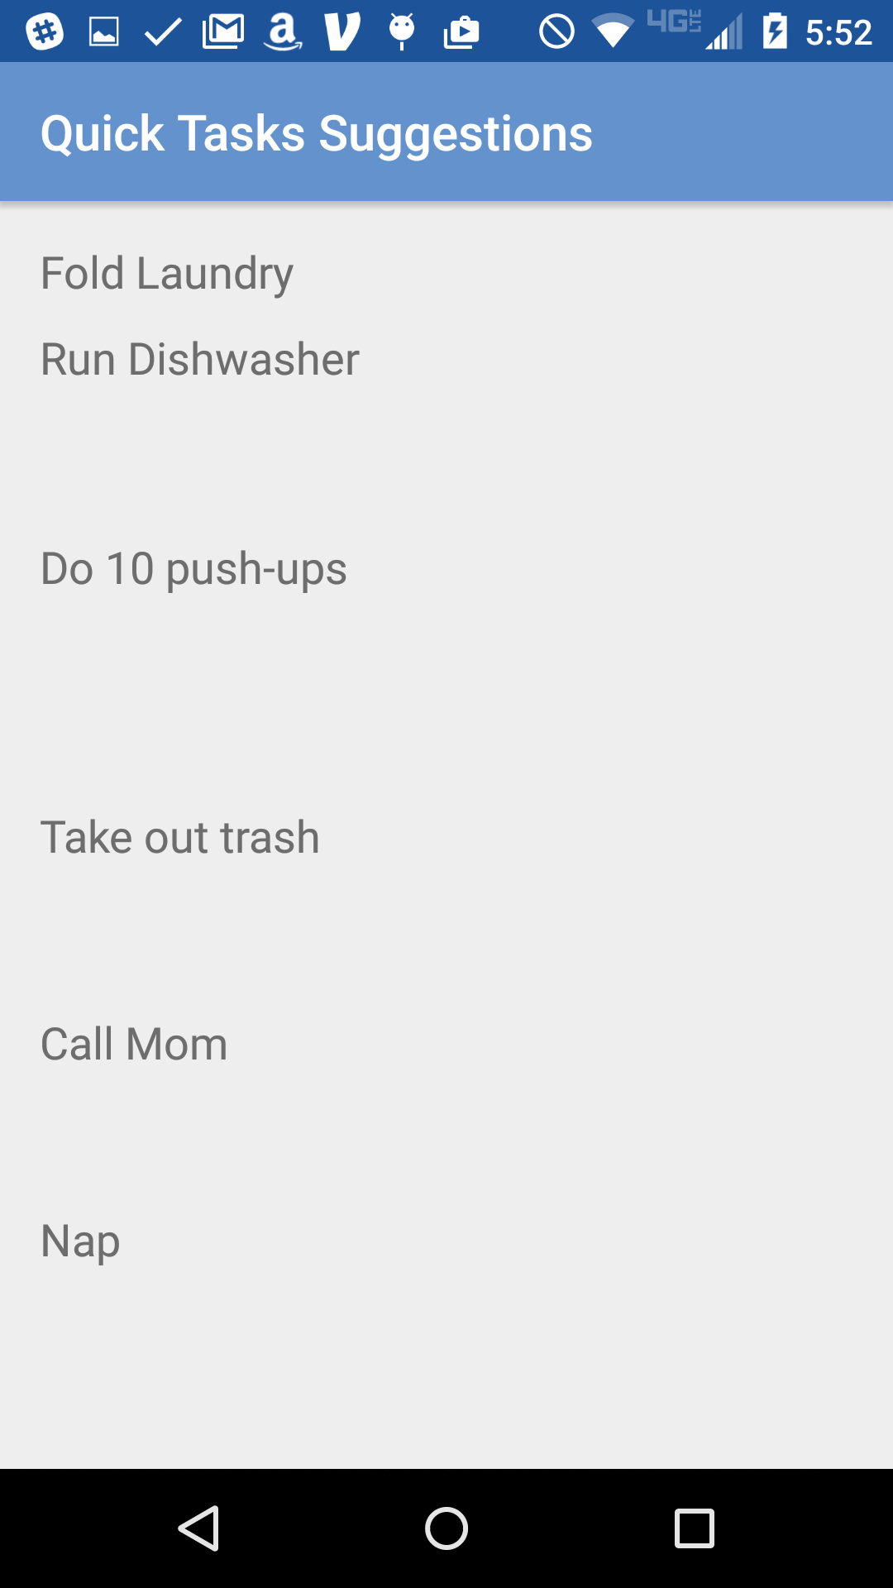
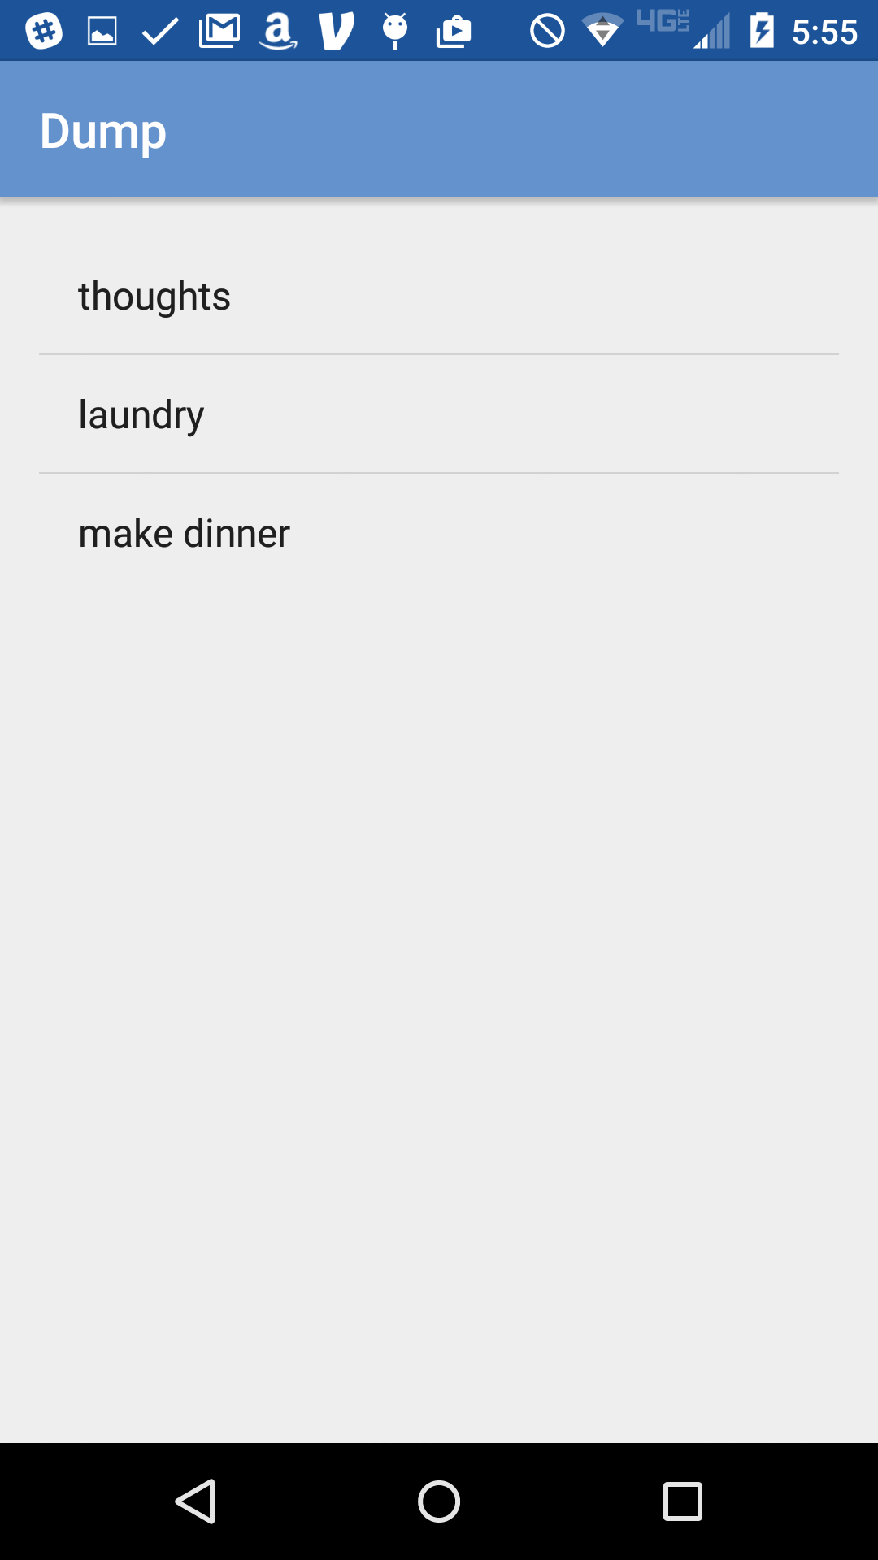
Screenshots/Demo
Notes:
Julia
We made the design of our user interface a priority since we wanted our app to be fun and easy to use. The transisitions between pages are intuitive and smooth.

Slide 7
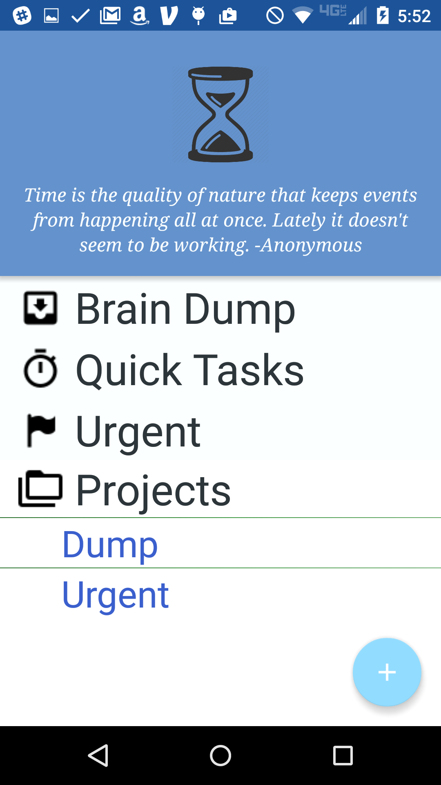
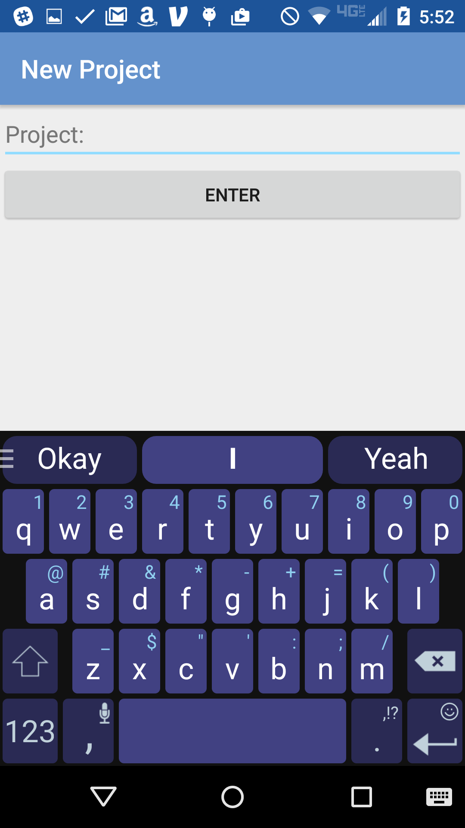
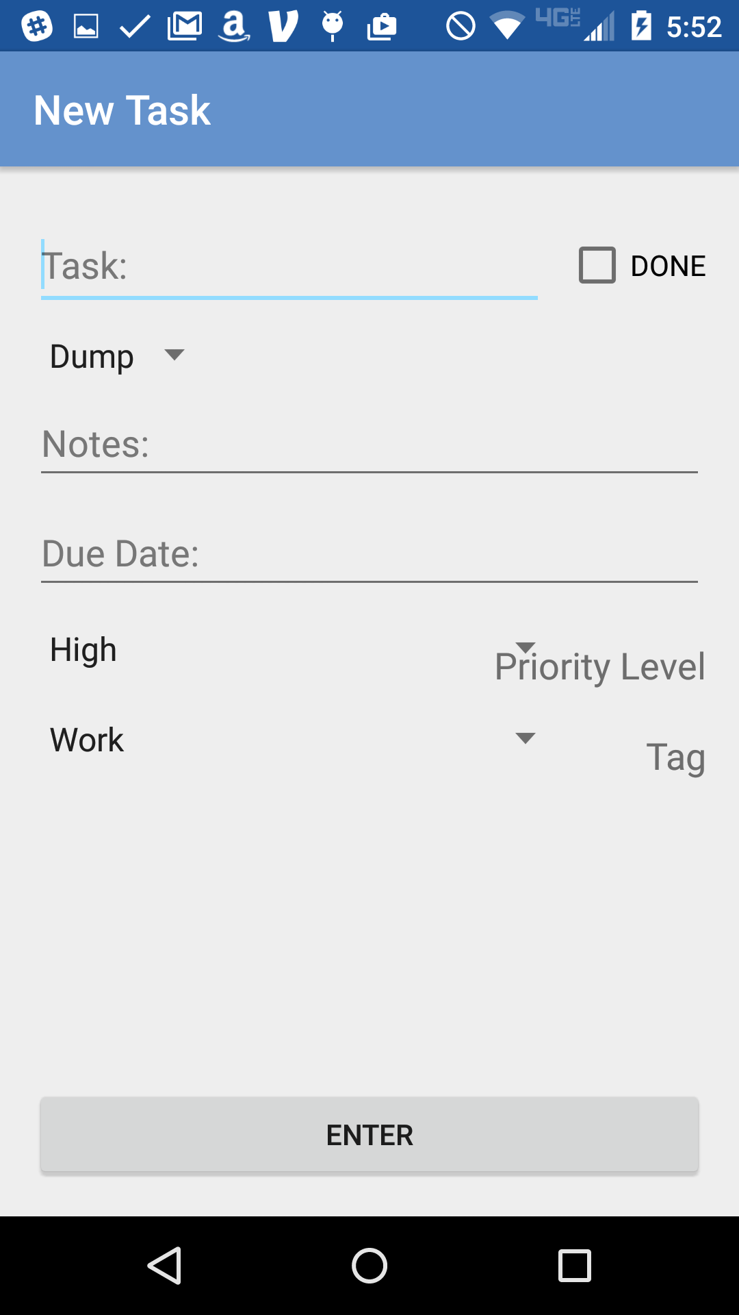
Screenshots/Demo
Notes:
Julia
We made the design of our user interface a priority since we wanted our app to be fun and easy to use. The transisitions between pages are intuitive and smooth.

Slide 8
Screenshots/Demo
Notes:
Julia
We made the design of our user interface a priority since we wanted our app to be fun and easy to use. The transisitions between pages are intuitive and smooth.

Slide 9
Accomplishments
Software Product:
Achieved a respectable representation of initial vision
Felt proud of result
Software Development Process:
Worked together effectively
Improved teamwork skills
Notes:
Brian
Although our initial vision was optimistic, we are glad we set our goals high and we feel satisfied with our result, which is a good representation of what we had in mind. We also feel that our ability to work together effectively was an accomplishment in itself.

Slide 10
Lessons Learned
What worked:
Having Scrum meetings regularly was effective
What didn’t work:
Communication wasn’t always thorough
What we now realize we should have been doing:
Collaborating more often earlier in the project
Notes:
Jeff
We all though having Scrum meetings regularly was a really effective way to stay on track and keep in touch with each other. However, outside of Scrum meetings we could have communicated more; we now realize that more collaboration and better communication earlier on would have helped us get the project moving faster.

Slide 11


Project Management Techniques
Processes:
Followed Scrum practices
Went through Sprint planning and Review as a team
Tools:
Online tutorials
Slack
GitHub
Notes:
Michaela
Our techniques mainly involved following the Scrum procedure closely as well as going through planning and review sessions together in-person. This helped us gain a collectively good understanding of how our project was going. Additionally, we all made use of online tutorials as well as slack for communication and GitHub for collaboration.

Slide 12
Reflections
Enjoyed:
Team building activities
Didn’t Enjoy:
Learning new technologies fast
Only having one week for each sprint
Only having one release
Notes:
Sergiy
In this project we enjoyed many team building activities such as tennis and ping pong which positively affected our ability to work together on the project. Fun activites like these also helped to negate the frustration caused by having to get through so much material at a fast pace.

Slide 13
Project Release Plan
Task Planner
Any Questions?
TP
TP
Notes:
Sergiy

